Slide 1
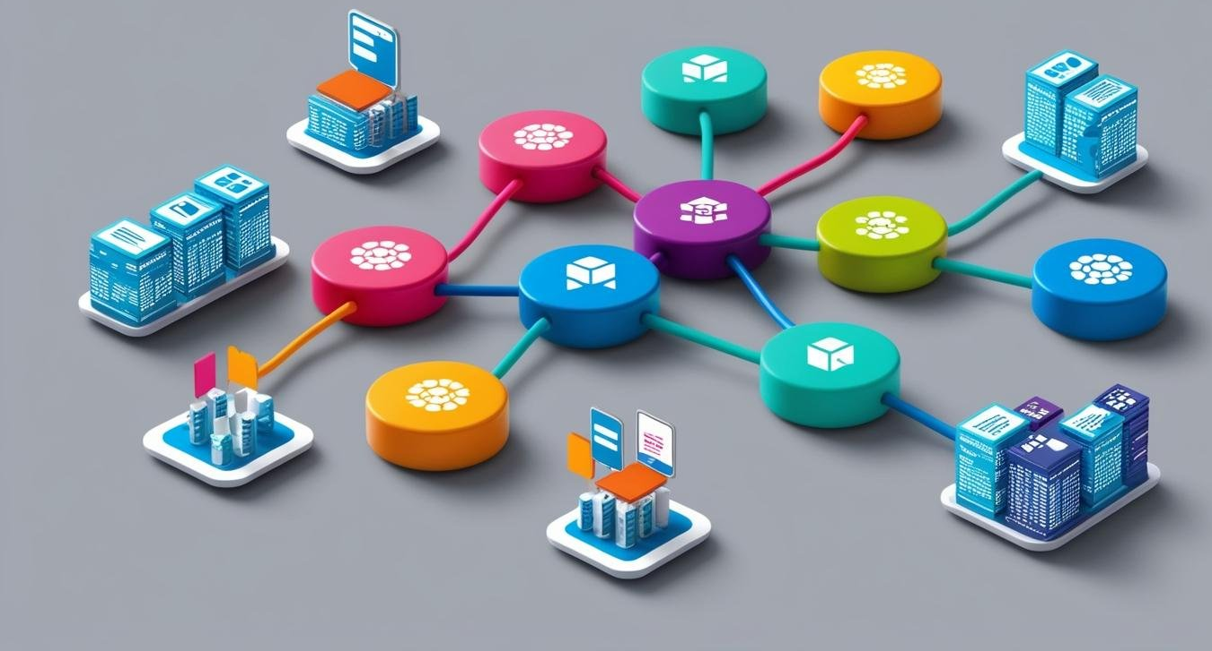
SYBCA – SEM-4
3. JSON – JavaScript Object Notation
Web Designing - 2

Slide 2

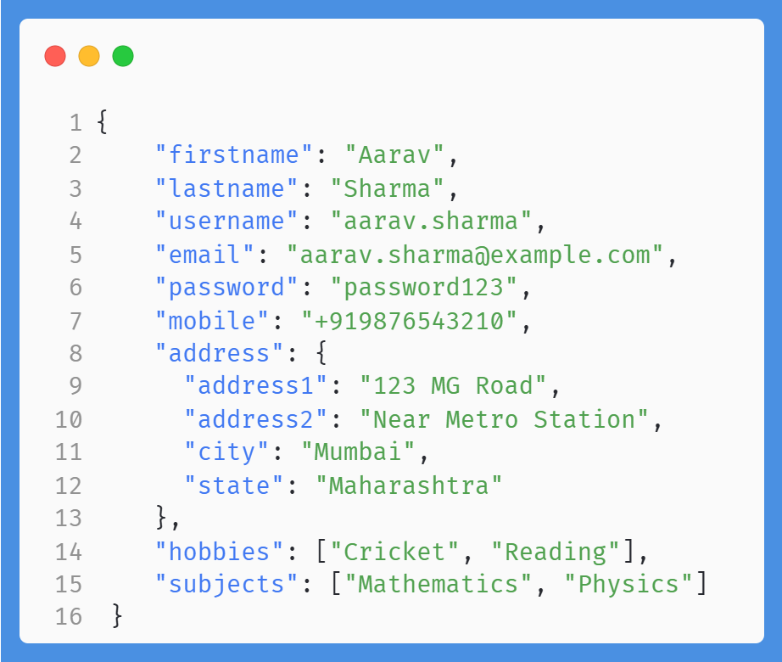
JSON
Concept & Features
Characteristics
Lightweight data-interchange format
Easy for humans to read and write
Simple structure: Key-value pairs
Language-independent, yet uses conventions of JavaScript

Slide 3
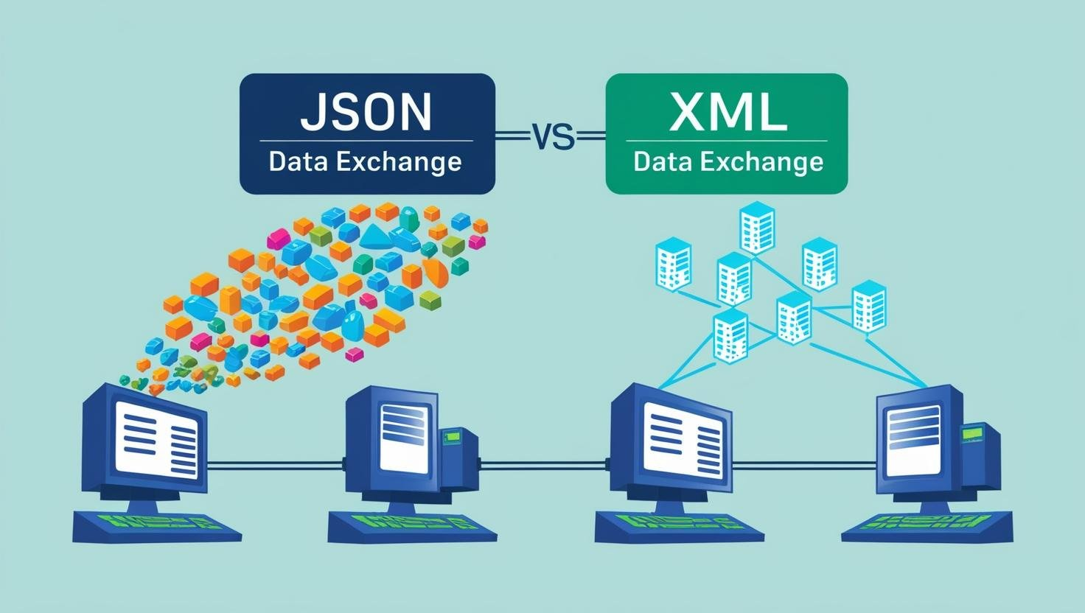
JSON vs. XML
Similarities
Similarities
Both are used for data interchange.
Human-readable and machine-readable.
Support nested structures.
Language/Platform Independent
Parsed and used by lots of programming languages
fetched with an XMLHttpRequest(AJAX)

Slide 4
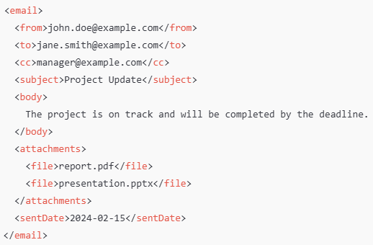
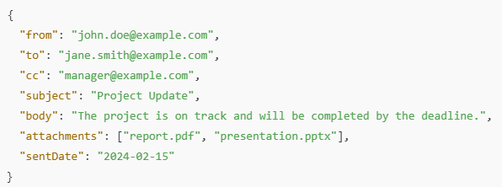
JSON vs. XML
XML
Differences
JSON is lightweight; XML is verbose.
JSON uses key-value pairs; XML uses tags.
JSON supports arrays; XML does not natively.
JSON does not require closing tags, unlike XML.
JSON

Slide 5
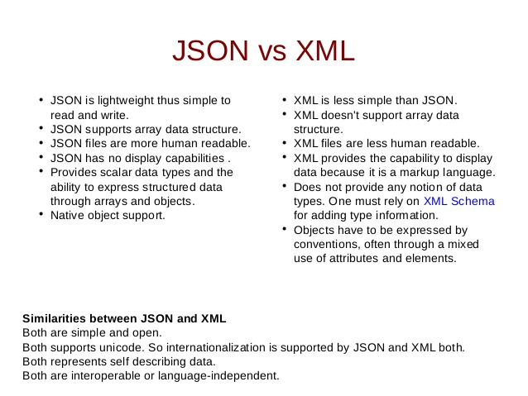
JSON vs. XML

Slide 6
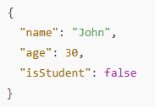
JSON Objects
Understanding JSON Objects
Key-value pairs format: { "key": "value" }
Data types: Strings, Numbers, Booleans, etc.

Slide 7
JSON Arrays
Introduction to JSON Arrays
Ordered list of values.
Can hold strings, numbers, booleans, objects, or arrays.
Syntax: [value1, value2, value3]
Array of Strings:
[“apple”, “banana”, “cherry”]
Array of Numbers:
[10, 20, 30]
Array of Booleans:
[true, false, true]

Slide 8
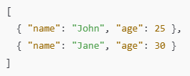
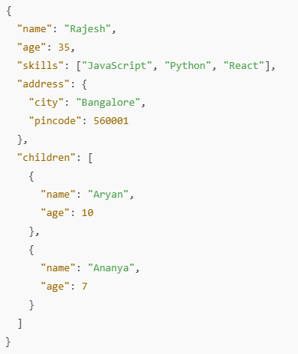
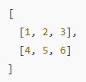
JSON Arrays
Array of Objects and Multi-Dimensional Arrays
Object of Arrays:
Array of Objects:
Multi-Dimensional Arrays

Slide 9

JSON Comments
Handling Comments in JSON
JSON does not natively support comments.

